Slide 1
OUTPUT
From new maps to enhanced decisions

Slide 2
Map as Output
Informed decision making and problem solving rely on the effective communication and exchange of ideas and information.
If GIS is to assist these activities the information it produces must be meaningful to users.
Users must be aware of the different forms information from GIS can take (including maps, statistics and tables of numbers).
The term ‘output’ is often used to describe the ways in which information from a GIS can be presented.

Slide 3
Map as Output
It should be remembered that there is a continuity between data, information, decision making and problem solving, and that output – good or bad will influence the decision-making process.
The most common form of output from GIS is a map.
In many cases the map will be thematic and will illustrate the spatial variation or pattern in a particular variable.
GIS output may be a three-dimensional model of a landscape, produced by draping land use data over a digital terrain surface.

Slide 4
MAPS AS OUTPUT
The role of the map is to communicate spatial information to the user.
This information may include location, size, shape, pattern, distribution and trends in spatial objects.
In designing a map so that it best achieves its objectives, it is necessary to consider a number of key map design elements. These include:
    the frame of reference;
    the projection used;
    the features to be mapped;
    the level of generalization;
    annotation used; and
    symbolism employed.

Slide 5
MAPS AS OUTPUT
When designing GIS maps we have the element of choice firmly on our side. The choices regarding
frame of reference, projection, scale, generalization, content and symbolism are ours.
We are in control and can manipulate the individual components of the map to suit our purpose.
However, with choice comes responsibility, and the choices made ultimately determine the effectiveness of the map as a communication tool.

Slide 6
MASPS AS OUTPUT
Since a map can be regarded as a scale model of the real world, it needs some form of spatial referencing so that the user can fix its location in ‘real-world space’.
A number of graphic and nongraphic devices are used for this purpose. A grid may be used to give a spatial frame of reference with lines representing latitude and longitude or planar (x,y) co-ordinates.
The spacing and labelling of the grid lines provide information on scale, and the orientation of the grid lines indicates which way the map is facing.
A north arrow may be used to show orientation without a grid, whilst a numeric scale or a graphical scale bar is often used to provide information regarding the size of the map relative to the real world.

Slide 7
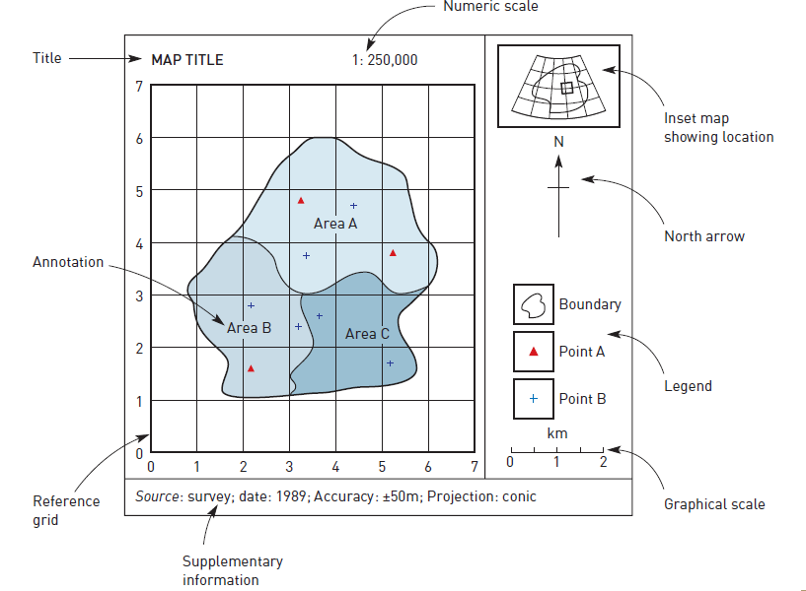
MAP COMPONENTS

Slide 8
MAS AS OUTPUT
An inset map showing the location of the main map area within its wider geographical setting is a very useful device in indicating approximate geographic location.
When drawing a map an appropriate map projection must be chosen.
For large-scale maps of small areas, planar co-ordinates derived from a local projection system are the obvious choice.
For maps of much larger areas, hard decisions often need to be made about which aspect of the map is most important: area, distances, directions or lines of true scale.

Slide 9
MAPS AS OUTPUT
Returning to the idea that maps are communication devices for spatial information, it is important that the map shows only what is necessary to get across the intended message.
A map should not contain anything that may detract from its intended purpose.
In other words, ‘there should be none of the extraneous objects or fancy flourishes typical of maps showing the location of hidden pirate treasure’.

Slide 10
MAPS AS OUTPUT
Needless and confusing embellishment is often referred to as ‘chart junk’ and should be avoided.
The level of detail shown in a map can also determine how well a map communicates information.
Too much detail and the map can become difficult to read, too little and essential information is lost.
In creating quality cartographic output, it is necessary to consider both the level of detail used in drawing geographical features (for instance, the number of co-ordinates used to represent a line) and the relative positions in which they are drawn on the map.

Slide 11
MAPS AS OUTPUT
The high level of precision at which co-ordinates are stored in the GIS data model does not help.
Simply plotting these coordinates directly onto the map can produce too much detail.
For example, in a map showing the road network that is to be published in a report, it may be necessary to remove some of the less important minor roads to avoid confusing the overall pattern.

Slide 12
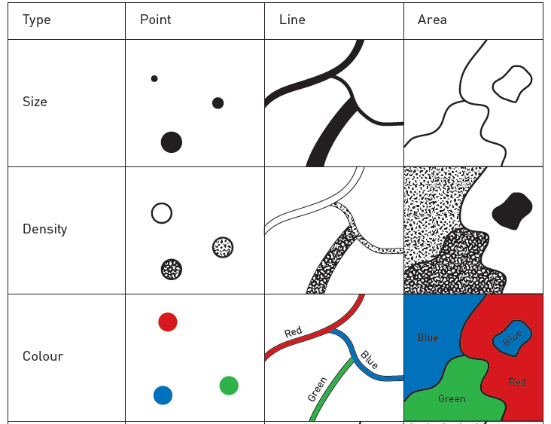
Cartographic symbolism

Slide 13
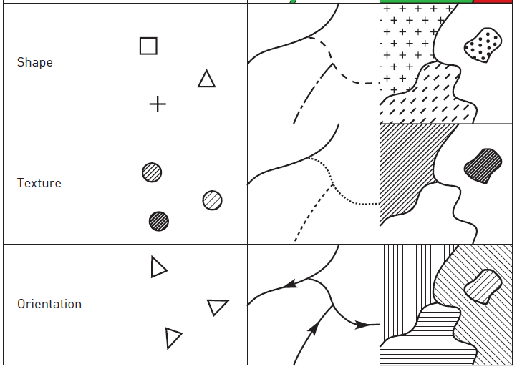
Cartographic symbolism

Slide 14
MAPS AS OUTPUT
In addition, it may be necessary to generalize the detail of main roads by thinning out selected vertices.
If the railway network was also to be portrayed on the same map, there is conflict for space where roads and railways run parallel to each other.
Plotted at a small scale, the roads and railway lines that follow close and parallel courses will plot directly on top of each other.
To avoid confusion between the two features we need to add a slight offset to the different line segments so that they appear to run close to each other but not directly one on top of the other.

Slide 15
MAPS AS OUTPUT
Generalizing map information may be done with less than honest intent.
The chosen method of map symbolism can also be important. Symbols on a map are either points, lines or areas.
Each symbol can differ in size, shape, density, texture, orientation and colour. A poor match between the real world and the symbol used to depict it may confuse the user as to its true nature.
It is for this reason that rivers are coloured blue and forests green. If they were coloured red and grey respectively, the user could be forgiven for mistaking the rivers for roads and the forests for urban areas.

Slide 16
MAPS AS OUTPUT
It would be a mistake to mix up the colours used to denote the standards on the resort map.
The standard international colour scheme is green (easy), blue (intermediate), red (advanced), black (expert).
Reversing this colour scheme could easily result in problems and even legal.
Thus, colour is important in influencing the user’s understanding of the map. The overall impact of the map can also be affected by colour and symbolism.

Slide 17
MAPS AS OUTPUT
Black and white maps that use differently shaped symbols and shading patterns can be effective for simple patterns and are certainly easier and cheaper to reproduce than colour maps.
However, colour may be necessary to effectively represent complex spatial patterns where detail would be lost in black and white maps.
The shape and pattern of the symbolism used also need to bear some relation to the feature being represented.
For example, it would be bad cartographic practice to use an anchor symbol to show the location of an airport and a lighthouse symbol to show the location of a public telephone.

Slide 18
MAPS AS OUTPUT
Returning to our road and rail example, if the railway lines were plotted as dashed black lines (– – – – – – –) and the main roads as black lines with short perpendicular hatching (++++++) instead of the other way around.
The map user may get the wrong impression since the crosshatched line symbol bears a closer resemblance to real railway lines.
Careful choice of shape and pattern of symbolism used can influence the user’s impression of the map.

Slide 19
MAPS AS OUTPUT
Finally, density and texture of shading can affect the impression given by a map.
In a monochrome choropleth map, high values may be represented by dense shading patterns (high density and coarse texture), whereas low values may be represented by lighter shading patterns (low density and fine texture).
A thematic map that displays a quantitative attribute using ordinal classes is called a choropleth map. Each class is assigned a symbolism, and this is applied over an area feature.

Slide 20
MAPS AS OUTPUT
Choropleth maps are frequently used to present classified data on socio-economic variables such as population or unemployment where these are mapped by regions, but can be adapted to a wide range of uses.
To ensure correct interpretation, whatever the symbolism used, it is essential that the map user is given the necessary information by a key or legend.
A key tells the user what the shading patterns, colours, line and point symbols mean and gives information about the class interval system used.
Without a key it would be difficult to interpret the mapped information accurately and confidently.

Slide 21
MAPS AS OUTPUT
Just as irrelevant detail and inappropriate symbolism can swamp the message in a map, then appropriate and economic use of annotation can help bring a map ‘to life’ and provide added meaning.
Annotation is textual and graphical information that either labels the map and features presented within it, or provides the user with supplementary information.
The visual and numeric guides to the frame of reference described above may be considered a form of annotation.

Slide 22
MAPS AS OUTPUT
More obvious uses of annotation include the map title, legend and labels given to mapped features.
Supplementary text may be added to a map to provide information about the data used and the mapping methods.
For example, information may be provided about data sources, quality estimates, projection system, reference system, copyright and other issues. ‘Parts undiscovered’ printed on a map showing the geography of the ‘Great Solar Eclipse’ of 14 July 1748 leaves the user in no doubt as to the quality of the mapped information in certain geographical regions. This is referred to as ‘metadata’.

Slide 23
MAPS AS OUTPUT
Map design is as much an art as it is a science. The primary objective is to ensure effective communication of the map’s theme(s).
This involves many technical decisions about scale, generalization and reference systems, but at the same time artistic decisions about positioning of map elements (title, legend, scale bar and north arrow) and the colour and symbolism used.
The artistic element can largely be a matter of personal preference, but certain conventions apply in certain circumstances.
A good starting point for developing an appreciation of cartographic design which looks at map design from an applied and theoretical perspective.

Slide 24
Alternative forms of cartographic output
Traditional maps normally assume that the observer is positioned directly overhead and is looking vertically down at the surface of the Earth.
Maps are drawn as plan views and at a fixed spatial scale. In recent years new forms of cartographic output have become more common.
These include cartograms, three-dimensional views and animation.

Slide 25
Alternative forms of cartographic output
At first sight cartograms look like normal maps. However, instead of showing the location of objects or variables using standard Euclidean co-ordinates, the objects depicted are mapped relative to another variable such as population density or relative distance.
In this manner, distances, directions and other spatial relationships are relative rather than absolute.
A common use of cartograms is for drawing maps of urban mass-transport networks. This type of cartogram is known as a routed line cartogram.

Slide 26
Alternative forms of cartographic output
Routes are plotted as generalized lines showing the sequence of stops and connections rather than showing the actual route taken.
In this manner the user’s understanding of the map and the spatial relationships between stops is greatly improved but often at the expense of true scale of distance between stops and the actual route taken.
A related form of cartogram shows space distorted from a central point on the basis of time taken or cost incurred to travel to a series of destination areas. These are known as central point linear cartograms.

Slide 27
Alternative forms of cartographic output
They have been used to show the relative costs of air travel to different parts of the world from one particular airport and how ticket prices are not uniformly determined by distance travelled.
Another use of cartograms is to depict the size of areas relative to their importance according to some non-spatial variable such as population or per capita income. These are referred to as area cartograms.
Three-dimensional (3D) views of spatial information are becoming a popular method of visualization.

Slide 28
Alternative forms of cartographic output
These display (x,y,z) co-ordinate information using an orthographic projection based on the angle of view (0–360 degrees around the compass view azimuth (0–90 degrees from horizontal to vertical) and view distance (distance of viewer from the image space).
The resulting image is an excellent means of displaying topographic data. It is also possible to drape other images over the wire frame map.
Thus, added realism may be created by draping land cover data derived from satellite imagery or aerial photographs over 3D terrain.

Slide 29
Alternative forms of cartographic output
Animation can be useful when there is a strong temporal element to the data being displayed. The first used animation as a means of identifying patterns in spatio-temporal data sets.
A series of maps is drawn, each showing the spatial pattern of the observed variable at a particular time. When ‘played back’ in quick succession as a series of frames, the change of the spatial pattern over time can be seen.
This technique has proved useful for identifying temporal patterns in point data sets and in visualizing diffusion processes.

Slide 30
Alternative forms of cartographic output
‘Computer movies’ have been used to analyze urban growth and crime incidents.
Animation may be used in a similar way to display all manner of spatio-temporal processes, from the development of forest fires and pollution plumes to changes in hydrological variables and population densities.
By combining the two techniques of 3D mapping and animation, modern GIS packages can create realistic ‘fly-through’ animation using a sequence of three dimensional images, each viewed from a different perspective.
This is a powerful means of terrain visualization, similar to the interactive computer animations seen in flight simulators.

